Slide 1
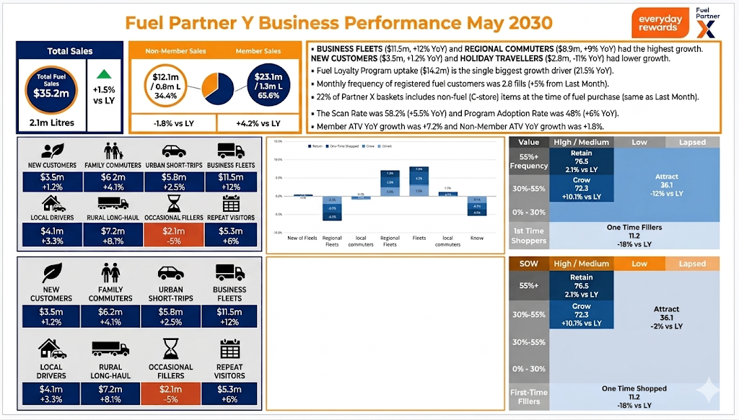
Fuel Partner Y Business Performance July 2029

